Slide 1
恶意代码分析与防治技术 第2章 基本静态分析技术
王志
zwang@nankai.edu.cn
南开大学 网络空间安全学院
2023-2024学年

Slide 2
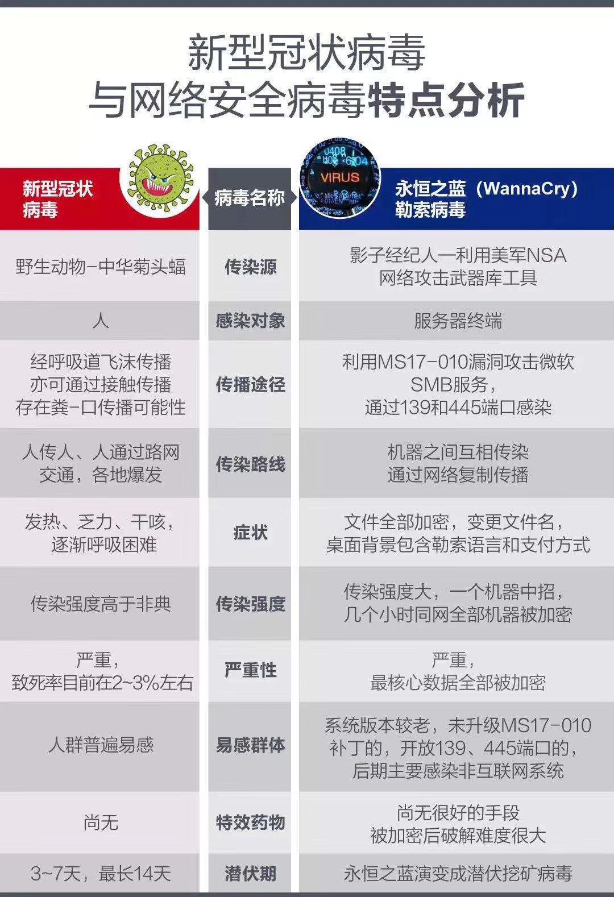

Slide 3
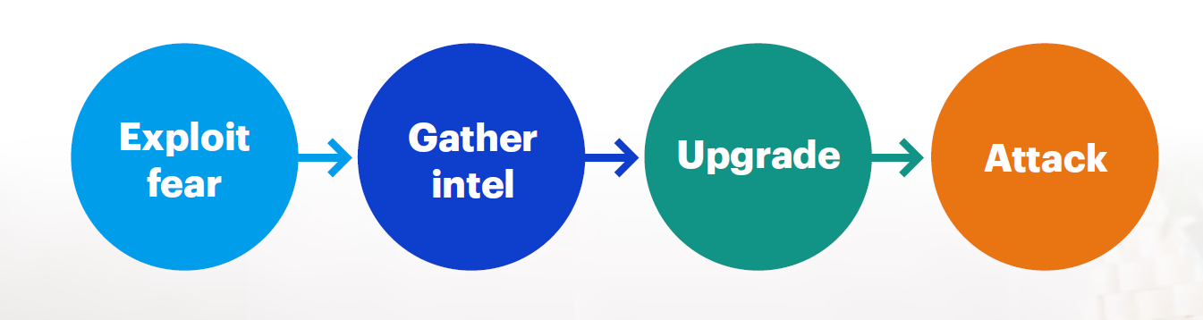
COVID-19 changed the threat landscape

Slide 4
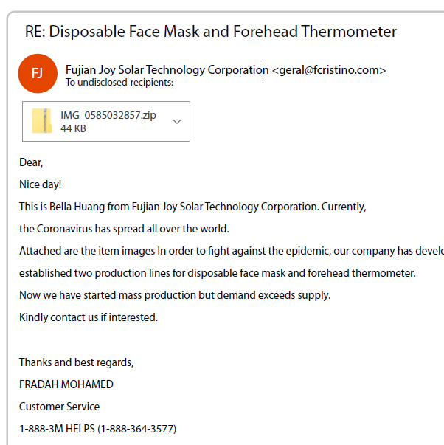
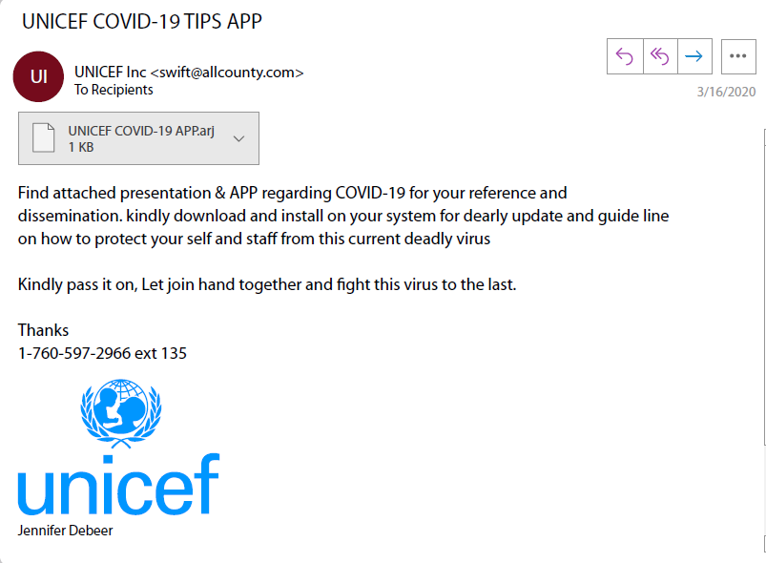
Exploit fear
In April, Google reported it was blocking 18 million spam emails related to COVID-19 per day!

Slide 5
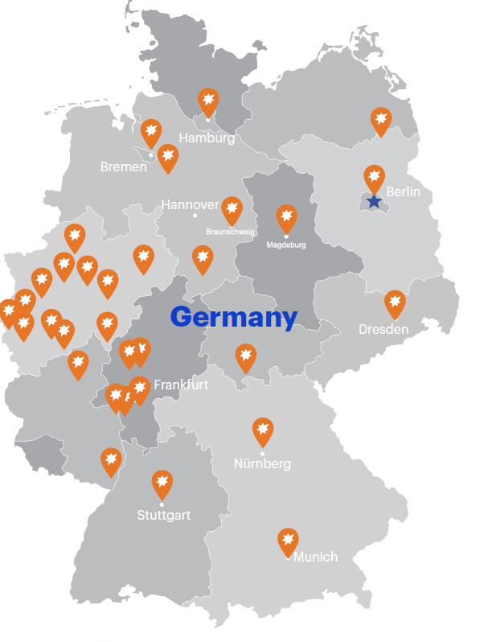
Malware as a business
Malware Distribution Services
On November 23, GootKit pushing the Revil ransomware to machines only in Germany.

Slide 6
本章知识点
Antivirus Scanning
Hashes
Finding Strings
Packed and Obfuscated Malware
Portable Executable File Format
Linked Libraries and Functions
Dependency Walker
The PE File Headers and Sections

Slide 7
Basic Static Analysis

Slide 8

主观题
10分
有哪些恶意代码的识别方法？
作答

Slide 9
Static Analysis
Reverse engineering the code or structure of a binary executable to understand its functionality.
Static analysis:
The program is not run at this time.
Notes:
Not coding , only reverse engineering

Slide 10
Basic Static Analysis
No disassembly
Provides good pointers to guide dynamic and advanced analysis
Lots of tools involved!

Slide 11
Techniques
Antivirus scanning
Hashes
A file’s strings, functions, and headers
Notes:
Extract useful information from binary programs.
We will discuss the following techniques
antivirus confirm the maliciousness
Hash identify malware

Slide 12
多选题
答案解析
2分
答案解析
使用基本静态分析我们能够获得哪些恶意代码的特征？
Basic static analysis不运行二进制代码，不进行反汇编。
可以从二进制代码里面找到没有被加密的信息，例如URLs、要感染的文件名、要修改的注册表键值、调用的Windows API函数名等等。
A
URLs
B
File Names
C
Registry Keys
D
API functions
提交
可为此题添加文本、图片、公式等解析，且需将内容全部放在本区域内。正常使用需3.0以上版本

Slide 13
Antivirus Scanning

Slide 14
主观题
答案解析
10分
答案解析
卡巴斯基、诺顿、Mcafee、Trend、
列出大家知道的杀毒软件名称。
正常使用主观题需2.0以上版本雨课堂
作答
可为此题添加文本、图片、公式等解析，且需将内容全部放在本区域内。正常使用需3.0以上版本

Slide 15

杀毒软件

Slide 16
Antivirus Scanning
Known malware
File signatures
Heuristics
Unknown malware
Obfuscation
Polymorphic: syntax obfuscation
Metamorphic: semantic obfuscation
Notes:
different antivirus tools have different file signatures and heuristics
Heuristic technique: finding the optimal solution is impossible or impractical, heuristic methods can be used to speed up the process of finding a satisfactory solution
Obfuscation: make it harder to understand
it is useful to run several different antivirus tools

Slide 17
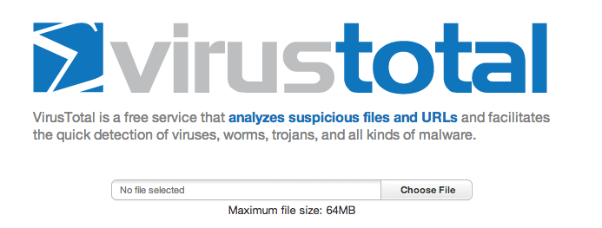
Collection of Antivirus Tools

Slide 18
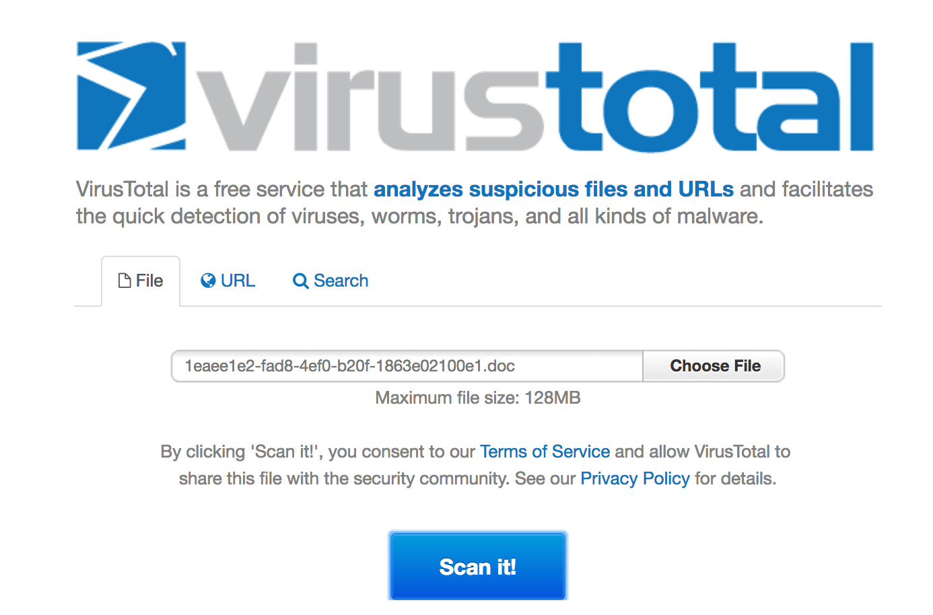

Slide 19
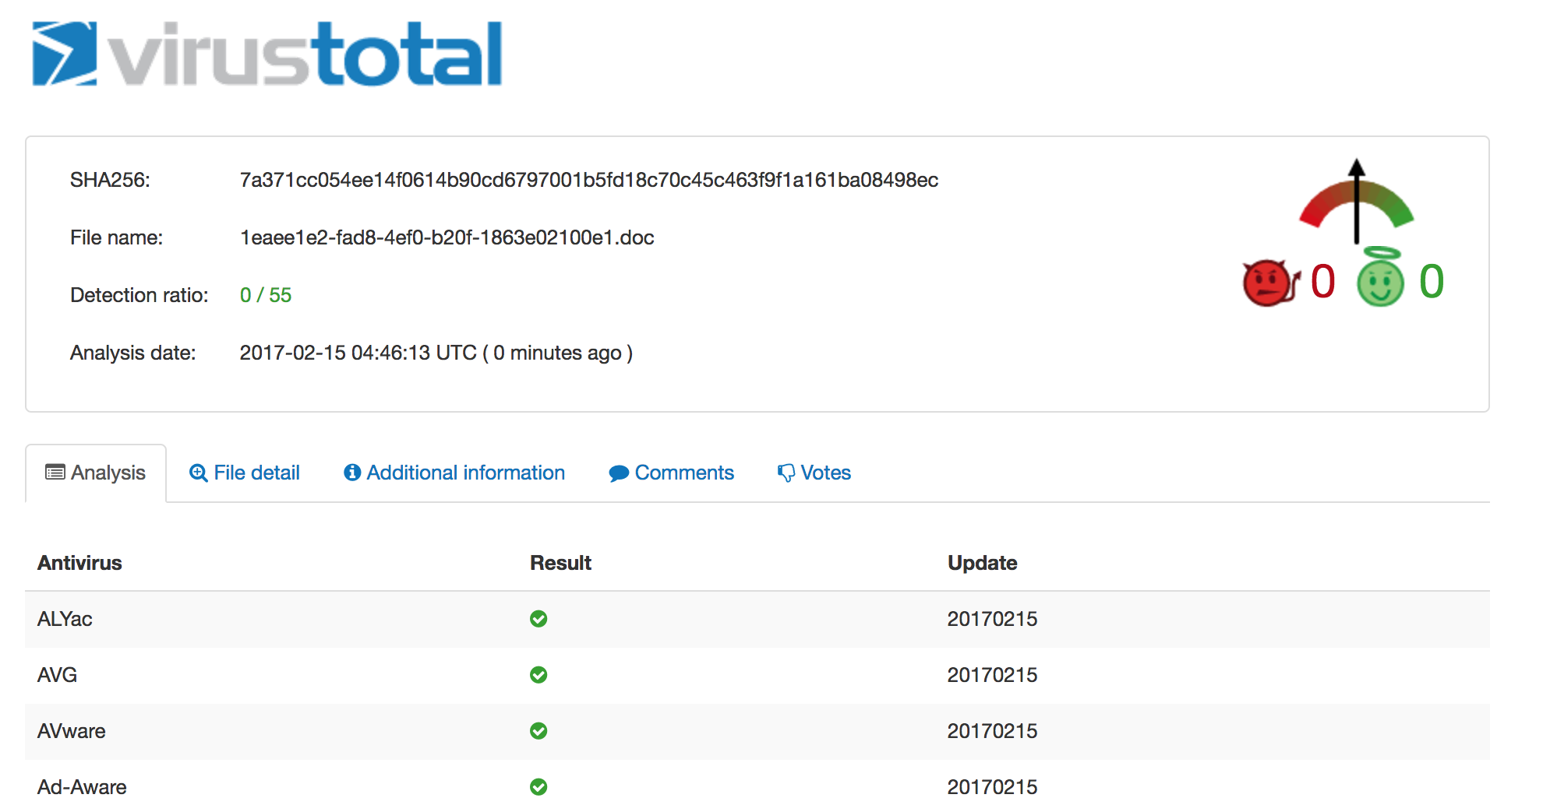

Slide 20
Hashing

Slide 21
主观题
答案解析
2分
答案解析
优点：准确，速度快
缺点：需要用到大量的hash值，很容易被躲避
为什么文件哈希值可以用来作为杀毒软件的特征？有哪些有点和缺点?
正常使用主观题需2.0以上版本雨课堂
作答
可为此题添加文本、图片、公式等解析，且需将内容全部放在本区域内。正常使用需3.0以上版本

Slide 22
Hashing
Method to uniquely identify malware
MD5
Message-Digest Algorithm
128-bit hash
SHA1
Secure Hash Algorithm
160-bit hash
Notes:
128 bit = 16 bytes = 8 words = 4 dwords
160 bit = 20 bytes = 10 words = 5 dwords
no int float long short unsigned signed ...

Slide 23
Hashes
Input:
A file or string with arbitrary length
Output:
fixed-length hash
Uniquely identifies a file well in practice
MD5 collisions but they are not common
Collision: two different files with the same hash
Notes:
collision is rare

Slide 24
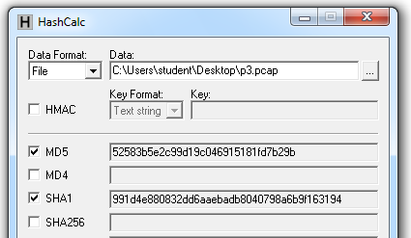
HashCalc
Notes:
confused, 128 bits , decimal numbers and a, b, c, d, e, f characters.
Hexadecimal format

Slide 25
Hash Uses
Label a malware file
Share the hash with other analysts to identify malware
Search the hash online to see if someone else has already identified the file
Notes:
390,000 new samples per day, naming is very difficult
reports published by antivirus companies, binary file hash are print out.

Slide 26
Finding Strings

Slide 27
Strings
String: a sequence of printable characters.
Computer can only understand 0 and 1
Use 0 and 1 to represent characters
ASCII
UNICODE
Notes:
print a message, connect URL, copy a file to specific location.
Get hints of functionality.

Slide 28
Strings
ASCII
American Standard Code for Information Interchange
8 bits long
UNICODE
Universal Coded Character Set
135 modern or historic scripts
16 bits long
Notes:
8 bits do not have enough space for Chinese characters

Slide 29
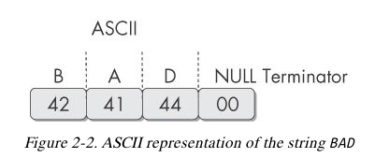
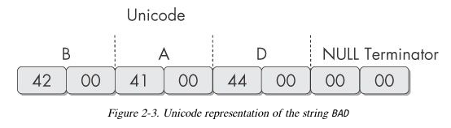
Notes:
Hexadecimal number
characters are stored in sequence with a null. Bad is stored as ASCII.
0X42 is the ASCII representation of capital letter B
as Unicode.

Slide 30
The strings Command
Search binary executable for ASCII and Unicode strings
Three or greater sequence of characters
Followed by a terminator

Slide 31
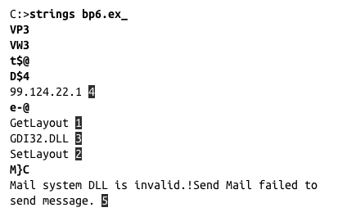
The strings Command
Notes:
invalid strings: obvious, not legitimate text, data; memory address; CPU instructions
Book p12

Slide 32
主观题
答案解析
2分
答案解析
字符串是否可以隐藏？ 躲避基于字符串的杀毒软件查杀。
加密、加壳、压缩、混淆
正常使用主观题需2.0以上版本雨课堂
作答
可为此题添加文本、图片、公式等解析，且需将内容全部放在本区域内。正常使用需3.0以上版本

Slide 33
Packed and Obfuscated Malware

Slide 34
Packed and Obfuscated Malware
Goals: Make malware more difficult to reverse engineering and detect
Obfuscation: conceal execution information
Packer: compress the size of binary file
a subset of obfuscation

Slide 35
Packer and Obfuscation
Legitimate Program
Many strings
Packed or Obfuscated Malware
few strings

Slide 36
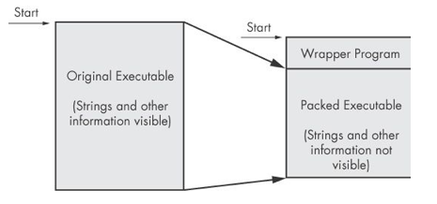
Packing Files
The code is compressed, like a Zip or RAR file
This makes the strings and instructions unreadable
All you'll see is the wrapper – small code that unpacks the file when it is running

Slide 37
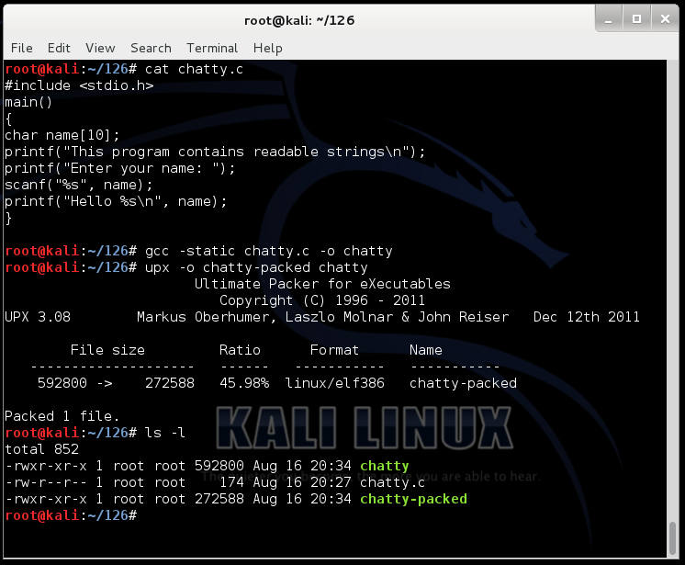
Demo: UPX

Slide 38
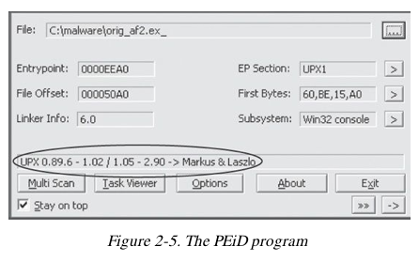
Detecting Packers with PEiD

Slide 39
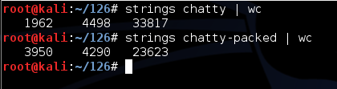
Packing Obfuscates Strings

Slide 40
多选题
答案解析
10分
答案解析
加壳技术和混淆技术有哪些作用？
压缩体积、隐藏重要信息，不一定减少字符串的数量，因为会出现很多垃圾字符串，而且也不会改变代码的功能
A
Compress file size
B
Hide URL and IPs
C
Conceal significant strings
D
Change code behaviors
提交
可为此题添加文本、图片、公式等解析，且需将内容全部放在本区域内。正常使用需3.0以上版本

Slide 41
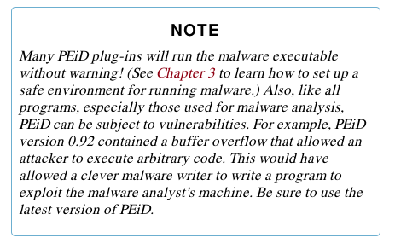

Slide 42
Portable Executable File Format

Slide 43
主观题
10分
文件头中有哪些信息可以作为恶意代码的特征？
作答

Slide 44
PE Files
Portable Executable File Format
Used by Windows executable files, and DLLs
Contains the information necessary for Windows to load the binary executable
Almost every file executed on Windows is in PE format

Slide 45
PE Header
Information about the code
Type of application
Required library functions
Space requirements

Slide 46
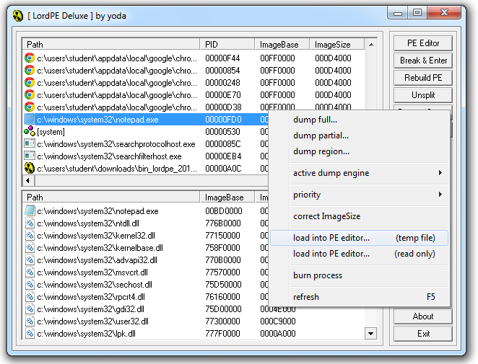
LordPE Demo

Slide 47
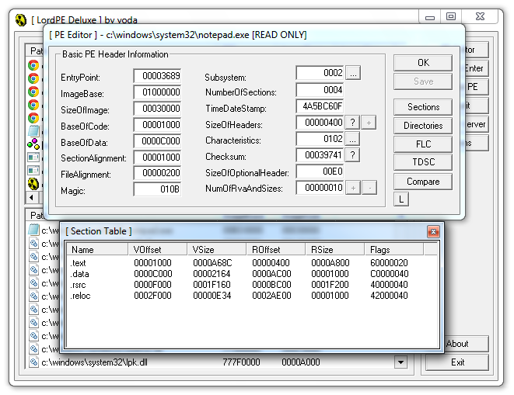
Main Sections

Slide 48
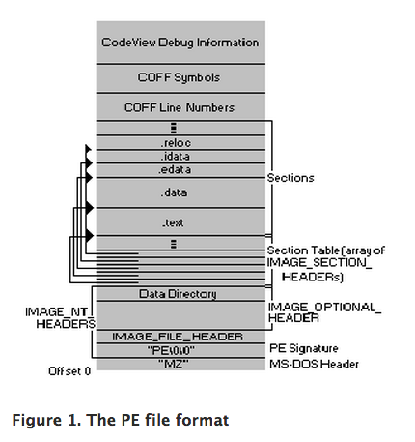
There are a lot more sections
But the main ones are enough for now

Slide 49
多选题
10分
在PE文件头中可以提取到哪些信息？
A
Type of application
B
Required library functions
C
Space requirements
D
Code entry point
提交

Slide 50
Linked Libraries and Functions

Slide 51
Imports
Functions used by a program that are stored in a different program, such as library
Connected to the main EXE by Linking
Can be linked three ways
Statically
At Runtime
Dynamically
Notes:
C++ include a library and use the function directly without give the implementation.

Slide 52
Static Linking
Rarely used for Windows executables
Common in Unix and Linux
All code from the library is copied into the executable
Bigger file size
More memory space

Slide 53
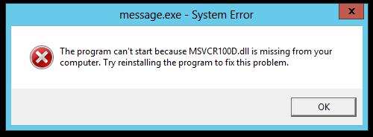
Dynamic Linking
Most common method
Host OS searches for necessary libraries when the program is loaded

Slide 54
Runtime Linking
Unpopular in friendly programs
Common in malware, especially packed or obfuscated malware
Connect to libraries only when needed, not when the program starts
Most commonly done with the LoadLibrary and GetProcAddress functions

Slide 55
Clues in Libraries
The PE header lists every library and function that will be loaded
Their names can reveal what the program does
URLDownloadToFile indicates that the program downloads something

Slide 56
多选题
2分
库文件有哪些装载的方式？
A
Static
B
Runtime
C
Dynamic
D
Obfuacated
提交

Slide 57
Dependency Walker

Slide 58
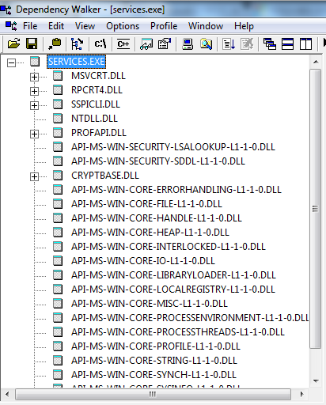

Slide 59
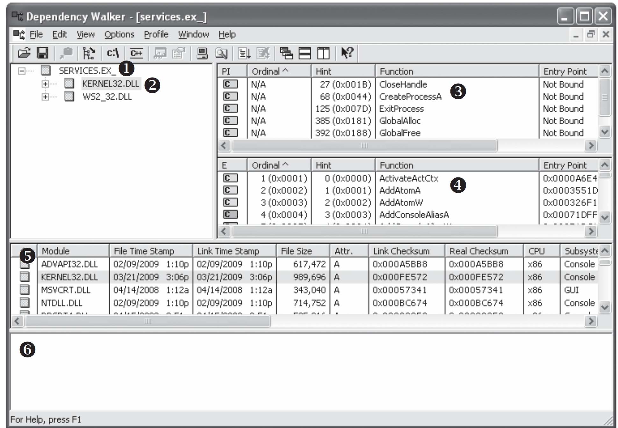
Notes:
3, 4 in book
page 16

Slide 60
Shows Dynamically Linked Functions
Normal programs have a lot of DLLs
Malware often has very few DLLs

Slide 61
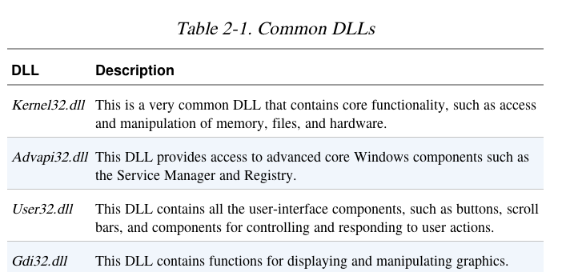

Slide 62
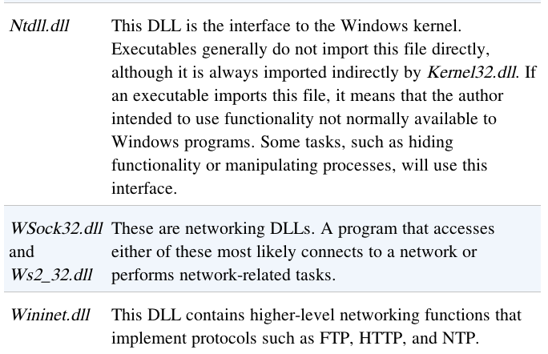

Slide 63
Exports
DLLs export functions
EXEs import functions
Both exports and imports are listed in the PE header

Slide 64
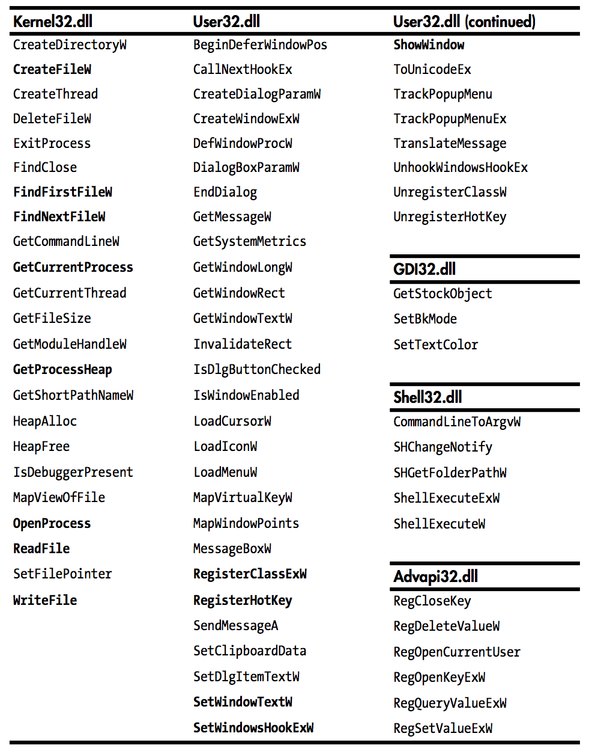
Static Analysis in Practice
Notes:
abridged list of functions imported by Potential Keylogger.exe
We wouldn't know this malware is a keylogger,
at first we should to look for functions to get clues
p20

Slide 65
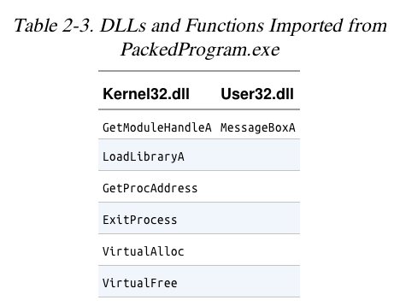
Ex: A Packed Program
Notes:
imports such a small number of functions, even less than Hello World program.
prevent us to understand the behavior
we need further advanced analysis

Slide 66
多选题
10分
下面哪些函数可以被加壳代码用来动态加载其它的API函数？
A
LoadLibrary
B
GetProcAddress
C
FindFirstFile
D
ShowWindow
提交

Slide 67
The PE File Headers and Sections

Slide 68
Important PE Sections
.text -- instructions for the CPU to execute
.rdata -- imports & exports
.data – global data
.rsrc – strings, icons, images, menus
Notes:
Based on the access attribute, the binary are split to different sections
The section names are decided by compilers
p21

Slide 69
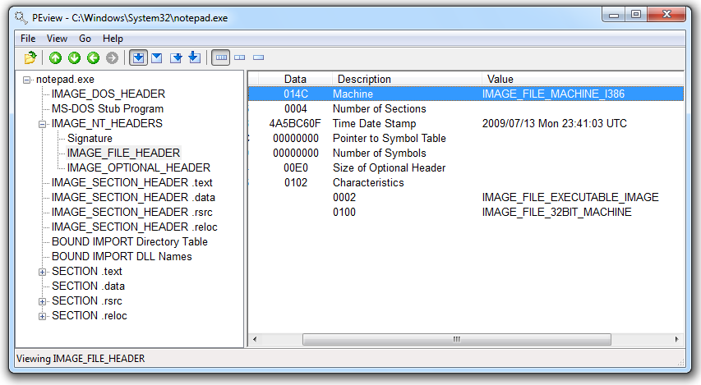
PEView

Slide 70
Time Date Stamp
Shows when this executable was compiled
Older programs are more likely to be known to antivirus software
But sometimes the date is wrong
All Delphi programs show June 19, 1992
Date can also be faked

Slide 71
IMAGE_SECTION_HEADER
Virtual Size – RAM
Size of Raw Data – DISK
For .text section, normally equal, or nearly equal
Packed executables show Virtual Size much larger than Size of Raw Data for .text section

Slide 72
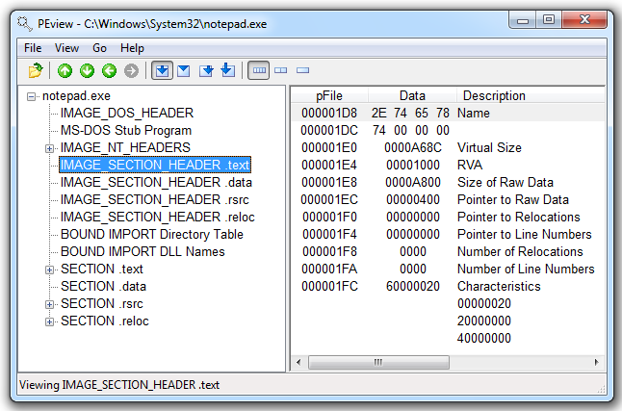

Slide 73
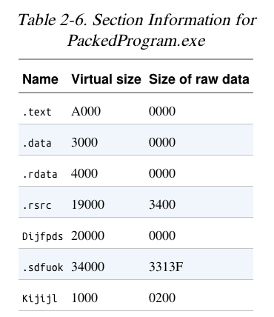

Slide 74
Resource Hacker
Lets you browse the .rsrc section
Strings, icons, and menus

Slide 75
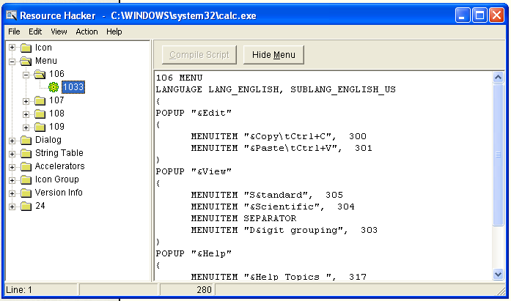
Resource Hacker in Windows XP

Slide 76
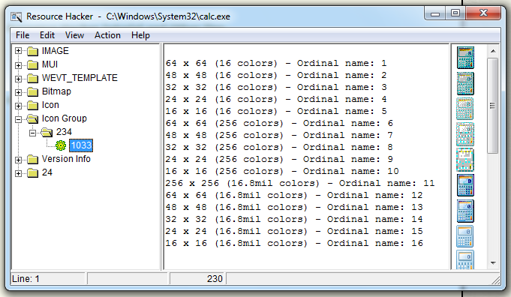
Resource Hacker in Windows 7

Slide 77
Labs
Practice our skills
In order to simulate realistic malware analysis, little or no information about the program is given.
generic names
meaningless or misleading names

Slide 78
Labs
Each lab consists
a malicious file
a few questions
short answers to the questions
a detailed analysis of the malware
The solutions are included in Appendix C
Notes:
two sections of answers. if you did the lab yourself, I will check the answers
Check your answer with the detailed explanation provided by our textbook.

Slide 79
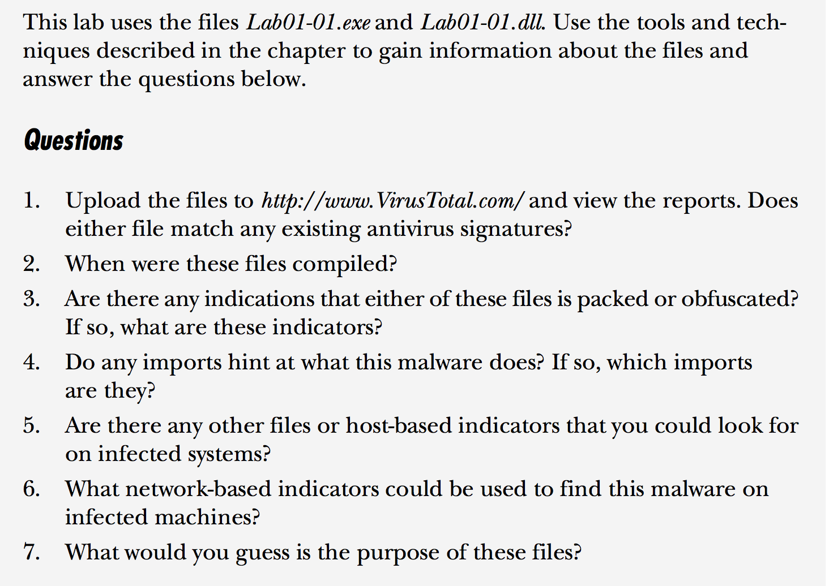
Lab 1 - 1

Slide 80
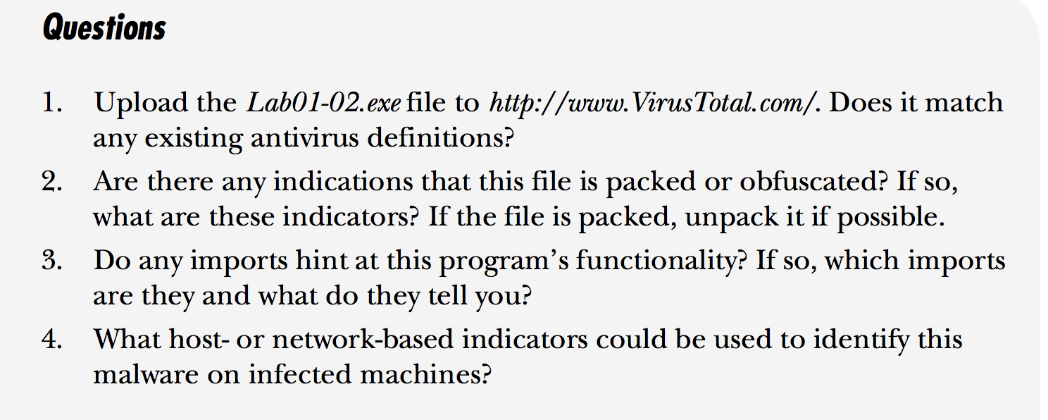
Lab 1-2

Slide 81
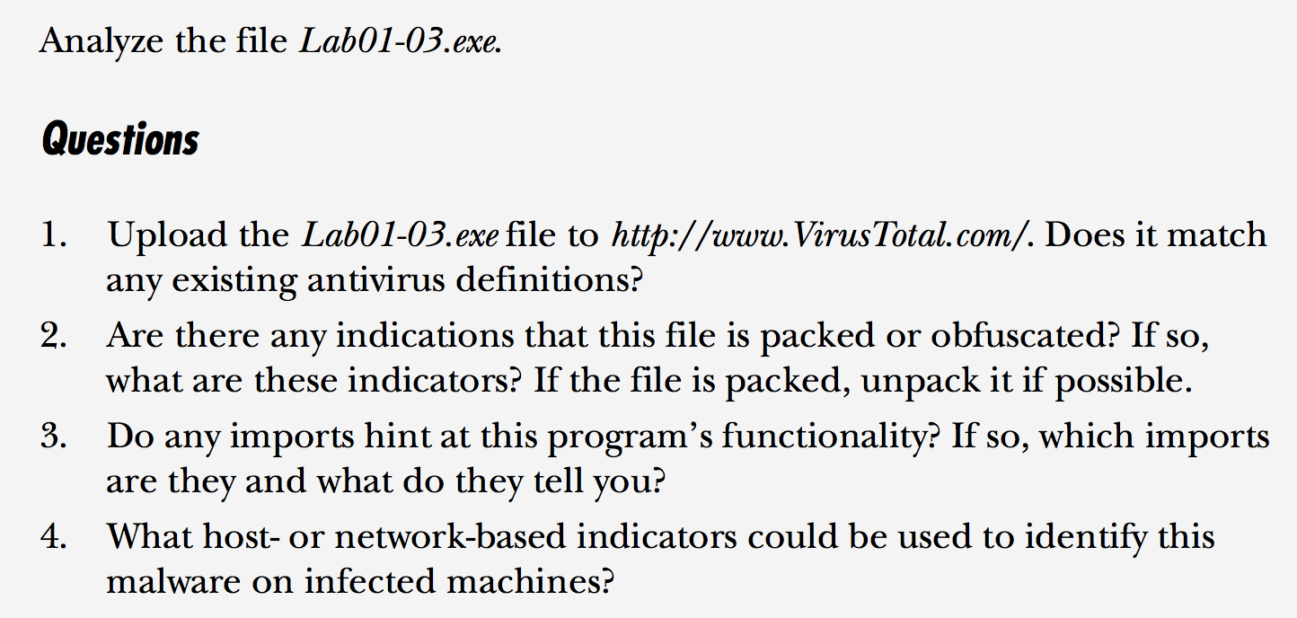
Lab 1-3

Slide 82
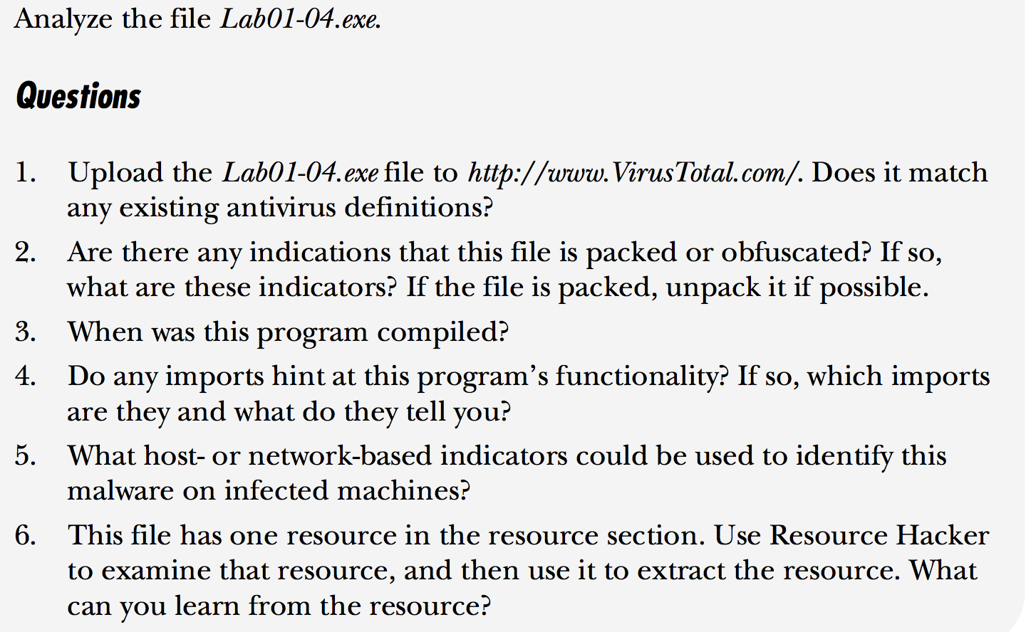
Lab 1- 4

Slide 83
实验报告提交
实验报告以附件的形式在雨课堂上提交。

Slide 84
恶意代码分析与防治技术 第2章 基本静态分析技术
王志
zwang@nankai.edu.cn
南开大学 网络空间安全学院
2023-2024学年

